Slide 1
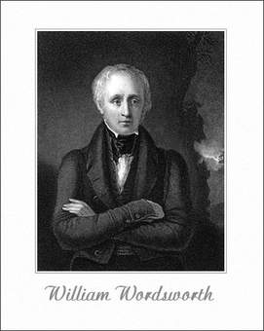
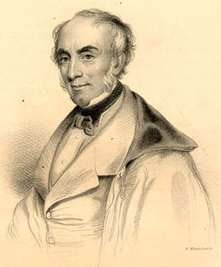
A Presentation on Wordsworth’s Function of Poetry by Dhokade R. S. Assit.Prof.& Head, Deptt.of English Swami Vivekanand Mahavidyalaya, Mukramabad
At
ICT Room

Slide 2
Introduction
Wordsworth’s ‘Preface to the Lyrical Ballads’ gives the long account of the nature, qualification and functions of poetry.
Traditionally the function of poetry was supposed to be both to instruct and to delight.
But for Wordsworth the function of poetry is to give pleasure.
However, his conception of pleasure is an exalted one.

Slide 3
1.Teaching
Some of the statements from Preface shed light on Wordsworth’s view of teaching as a function of poetry.
He calls poetry – the most philosophical of all writings; the breath and finer spirit of all knowledge; the impassioned expression that is the countenance of all science and the image of man and nature.
Again, Wordsworth gives importance to teaching quality of poetry is seen through letter written to a friend.
He writes, “Every great poet is a teacher.
I wish either to be considered as a teacher or as nothing’

Slide 4
2. Delight
Wordsworth gives first importance to pleasure as the primary function.
But, he differs from the Neo-classics.
The Neo-classics gave equal importance both to instruct and delight.
Wordsworth’s conception of pleasure is not aesthetic only.
His conception of pleasure is moral.
Poetry aims at pleasure which is much higher, the pleasure which results from the realization of truth.
Wordsworth says that poetry makes the readers saner and purer than before.

Slide 5
3. To Console and to give Strength to readers
According to Wordsworth, poetry is a source of consolation and strength.
The poetry consoles the afflicted, adds sunshine to daylight by making the happy happier.
It makes the reader to see, to think and to feel better and become more active and virtuous.
The poet is the rock of defense for human nature.
He gives his readers every strength of life to lead life in a better manner.

Slide 6
4. Knowledge and Truth
Wordsworth firmly believed that his poetry discovered the truth of nature.
He thought the mission of poetry is to discover something fresh and original in the beauty of nature, in the mind of man and to teach to communicate this truth to his readers.
He says, poetry increases our knowledge of human life and human nature.
It makes us wiser and also nobler and better.
The truths of poetry are universal and general, while the truths of science are merely personal and particular.

Slide 7
5. A Force for Good
To Wordsworth, Poetry is a force for good.
He talked of benign tendencies of poetry in his Preface.
He called them ‘relationship and love’.
He thought to promote this relationship and love is the main function of poetry.

Slide 8
Conclusion
Thus, Wordsworth had an exalted and noble conception of poetry and its function.
He reconciles ‘pleasure’ and ‘teaching’ and fuses them into a whole.
It is said Wordsworth has much common with Plato when he talks of poetic teaching.
But he stresses more on ‘pleasure’.

Slide 9
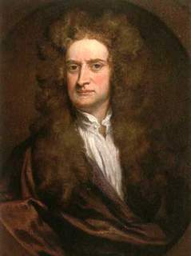
PowerPoint 2013
Thank You!
(Click the arrow when in Slide Show mode)
Notes:
In Slide Show mode, click the arrow to enter the PowerPoint Getting Started Center.

