Slide 1
lgk- izk/;kid HkkjrHkw”k.k oke.kjko ckGcq/ks
lSfudh foKku foHkkx
Lokeh foosdkuan egkfo|ky; eqdzekckn
rk- eq[ksM ftYgk ukansM
Egkjk”V~jkT; 431719

Slide 2
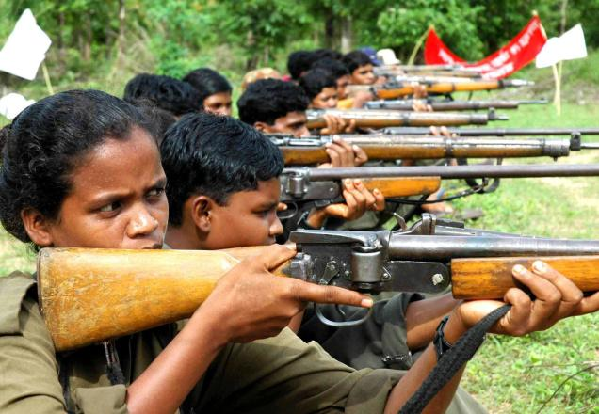
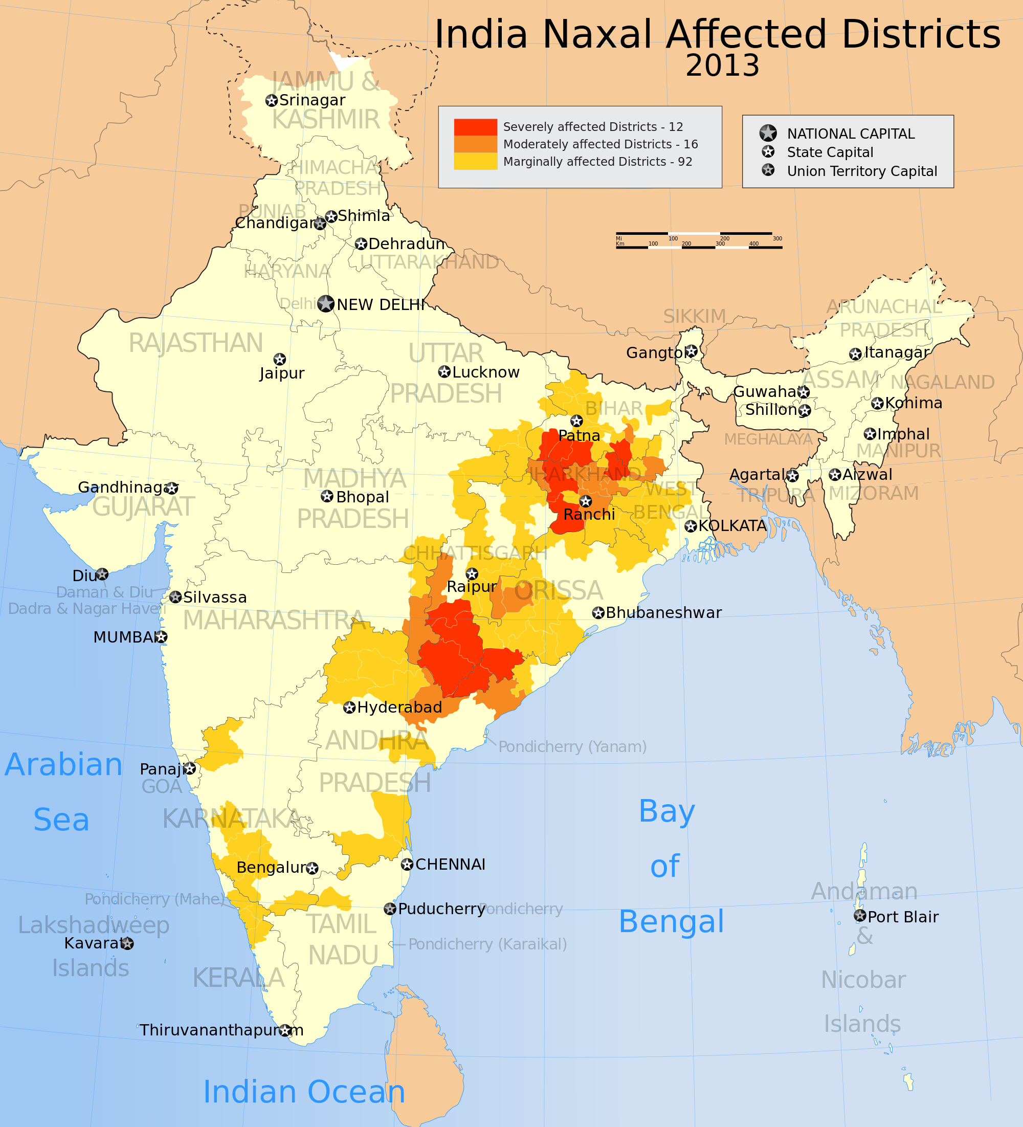
u{kyoknh pGoGhus izHkkfor jkT;s

Slide 3
u{kyoknh pGoGhpk ifj.kke
u{kyoknkpk vkfnoklh {ks=krhy eqykaoj ifj.kke
lqf’k{khr r:.kkaph Hkjrh dj.;kl lqjokr
fHkrheqGs ‘kkGsr tk.ks can-
cGtcjhus ‘kkGsrwu iyk;.k d:.k izf’k{k.k ns.ks-
u{kyh dkjok;keqGs ‘kkGk can iMY;k-
eqykaps lgt c/nhifjorZ.k dj.ks lksis tkrs-

Slide 4
u{kyoknkpk jk”Vh; lqj{ksojhy ifj.kke-
[kfutlaiRrhP;k HkqHkkxkr okLrO; R;keqGs vkfFkZd ifj.kke
?kkrikr dsY;keqgs okgrqd lqfo/kkaoj ifj.kke-
u{kyh cankscLrklkBh dsanz o jkT;kauk eksB;k izek.kkr iSlk o ‘kDrh [kpZ djkok ykxr vkgs-
fodkl dkekr vMFkMk vk.kY;keqGs yksdkae/;s ljdkj oh”k;d ukjkth ok<r vkgs-
ljdkj vkf.k u{kyokn;kae/;s lkekU; yksdkapk cGh-
yksd’kkgh iq<s ladV fuekZ.k gksr vkgs
u{kyokn;akpk cankscLr dj.;kklkBh lSU;kpk okij dsY;k eqGs ijdh; ‘k=wdMs nyZ{k-

Slide 5
/kU;okn

