Slide 1
lgk- izk/;kid HkkjrHkw”k.k oke.kjko ckGcq/ks
lSfudh foKku foHkkx
Lokeh foosdkuan egkfo|ky; eqdzekckn
rk- eq[ksM ftYgk ukansM
Egkjk”V~jkT; 431719

Slide 2
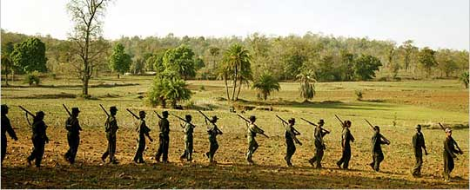
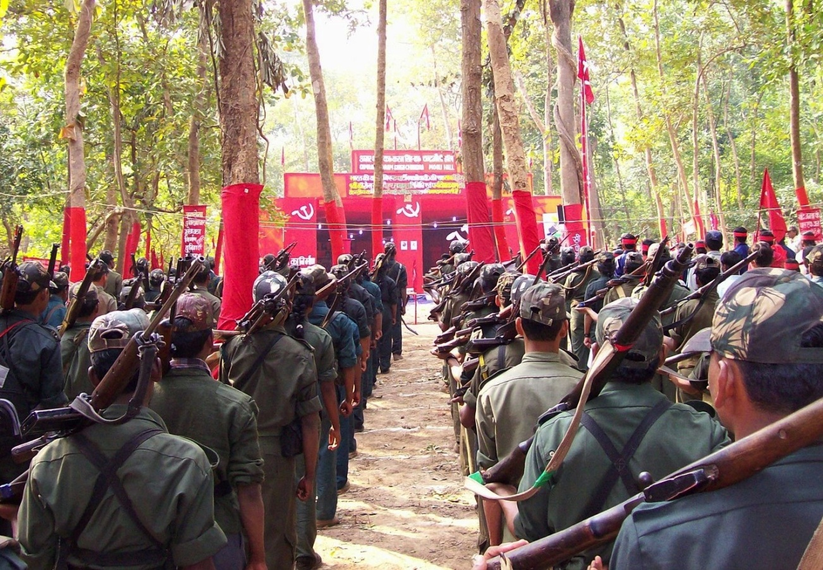
u{kyoknh pGoGhph vf/kos’k o”kZ 2006

Slide 3
u{kyoknkph dkj.ks
vkfnoklh {ks=krhy fodklkdMs >kysys ljdkjps nyZ{k-
Tfeunko o ljdkj ;kaP;kdMwu gks.kkjh fiGo.kwd-
izLrkihrkaP;k vU;k;keqGs vkfnoklh u{kyokn;kdMs vks<ys xsys-
‘kkldh; ;a=.ksdMwu gks.kkjk Hkz”Vkpkj o xSjO;ogkj-
‘ksretwj o Hkwfeghu ;kaP;k gDdkdMs gks.kkjs nqyZ{k-
xjhc Jherh e/khy fo”kerk-
jkT;krhy dqiz’kklu
vkfnoklhuk miftohdsps lk/ku ulY;keqGs u{kyokn;kadMs vks<ys xsys-
Okulainsps eksB;k izek.kkr vigj.k-
nqjxe Hkkxkr izkFkehd iz’ukuoj ‘kklukps nqyZ{k-

Slide 4
/kU;okn

